Slide 1

Database Environment

Slide 2

Purpose of three-level database architecture.
Contents of external, conceptual, and internal levels.
Purpose of external/conceptual and conceptual/internal mappings.
Meaning of logical and physical data independence.
Distinction between DDL and DML.
A classification of data models.

Slide 3

Purpose/importance of conceptual modeling.
Typical functions and services a DBMS should provide.
Software components of a DBMS.
Meaning of client–server architecture and advantages of this type of architecture for a DBMS.
Function and uses of Transaction Processing Monitors.
Function and importance of the system catalog.

Slide 4

All users should be able to access same data.
A user’s view is immune to changes made in other views.
Users should not need to know physical database storage details.

Slide 5
DBA should be able to change database storage structures without affecting the users’ views.
Internal structure of database should be unaffected by changes to physical aspects of storage.
DBA should be able to change conceptual structure of database without affecting all users.

Slide 6

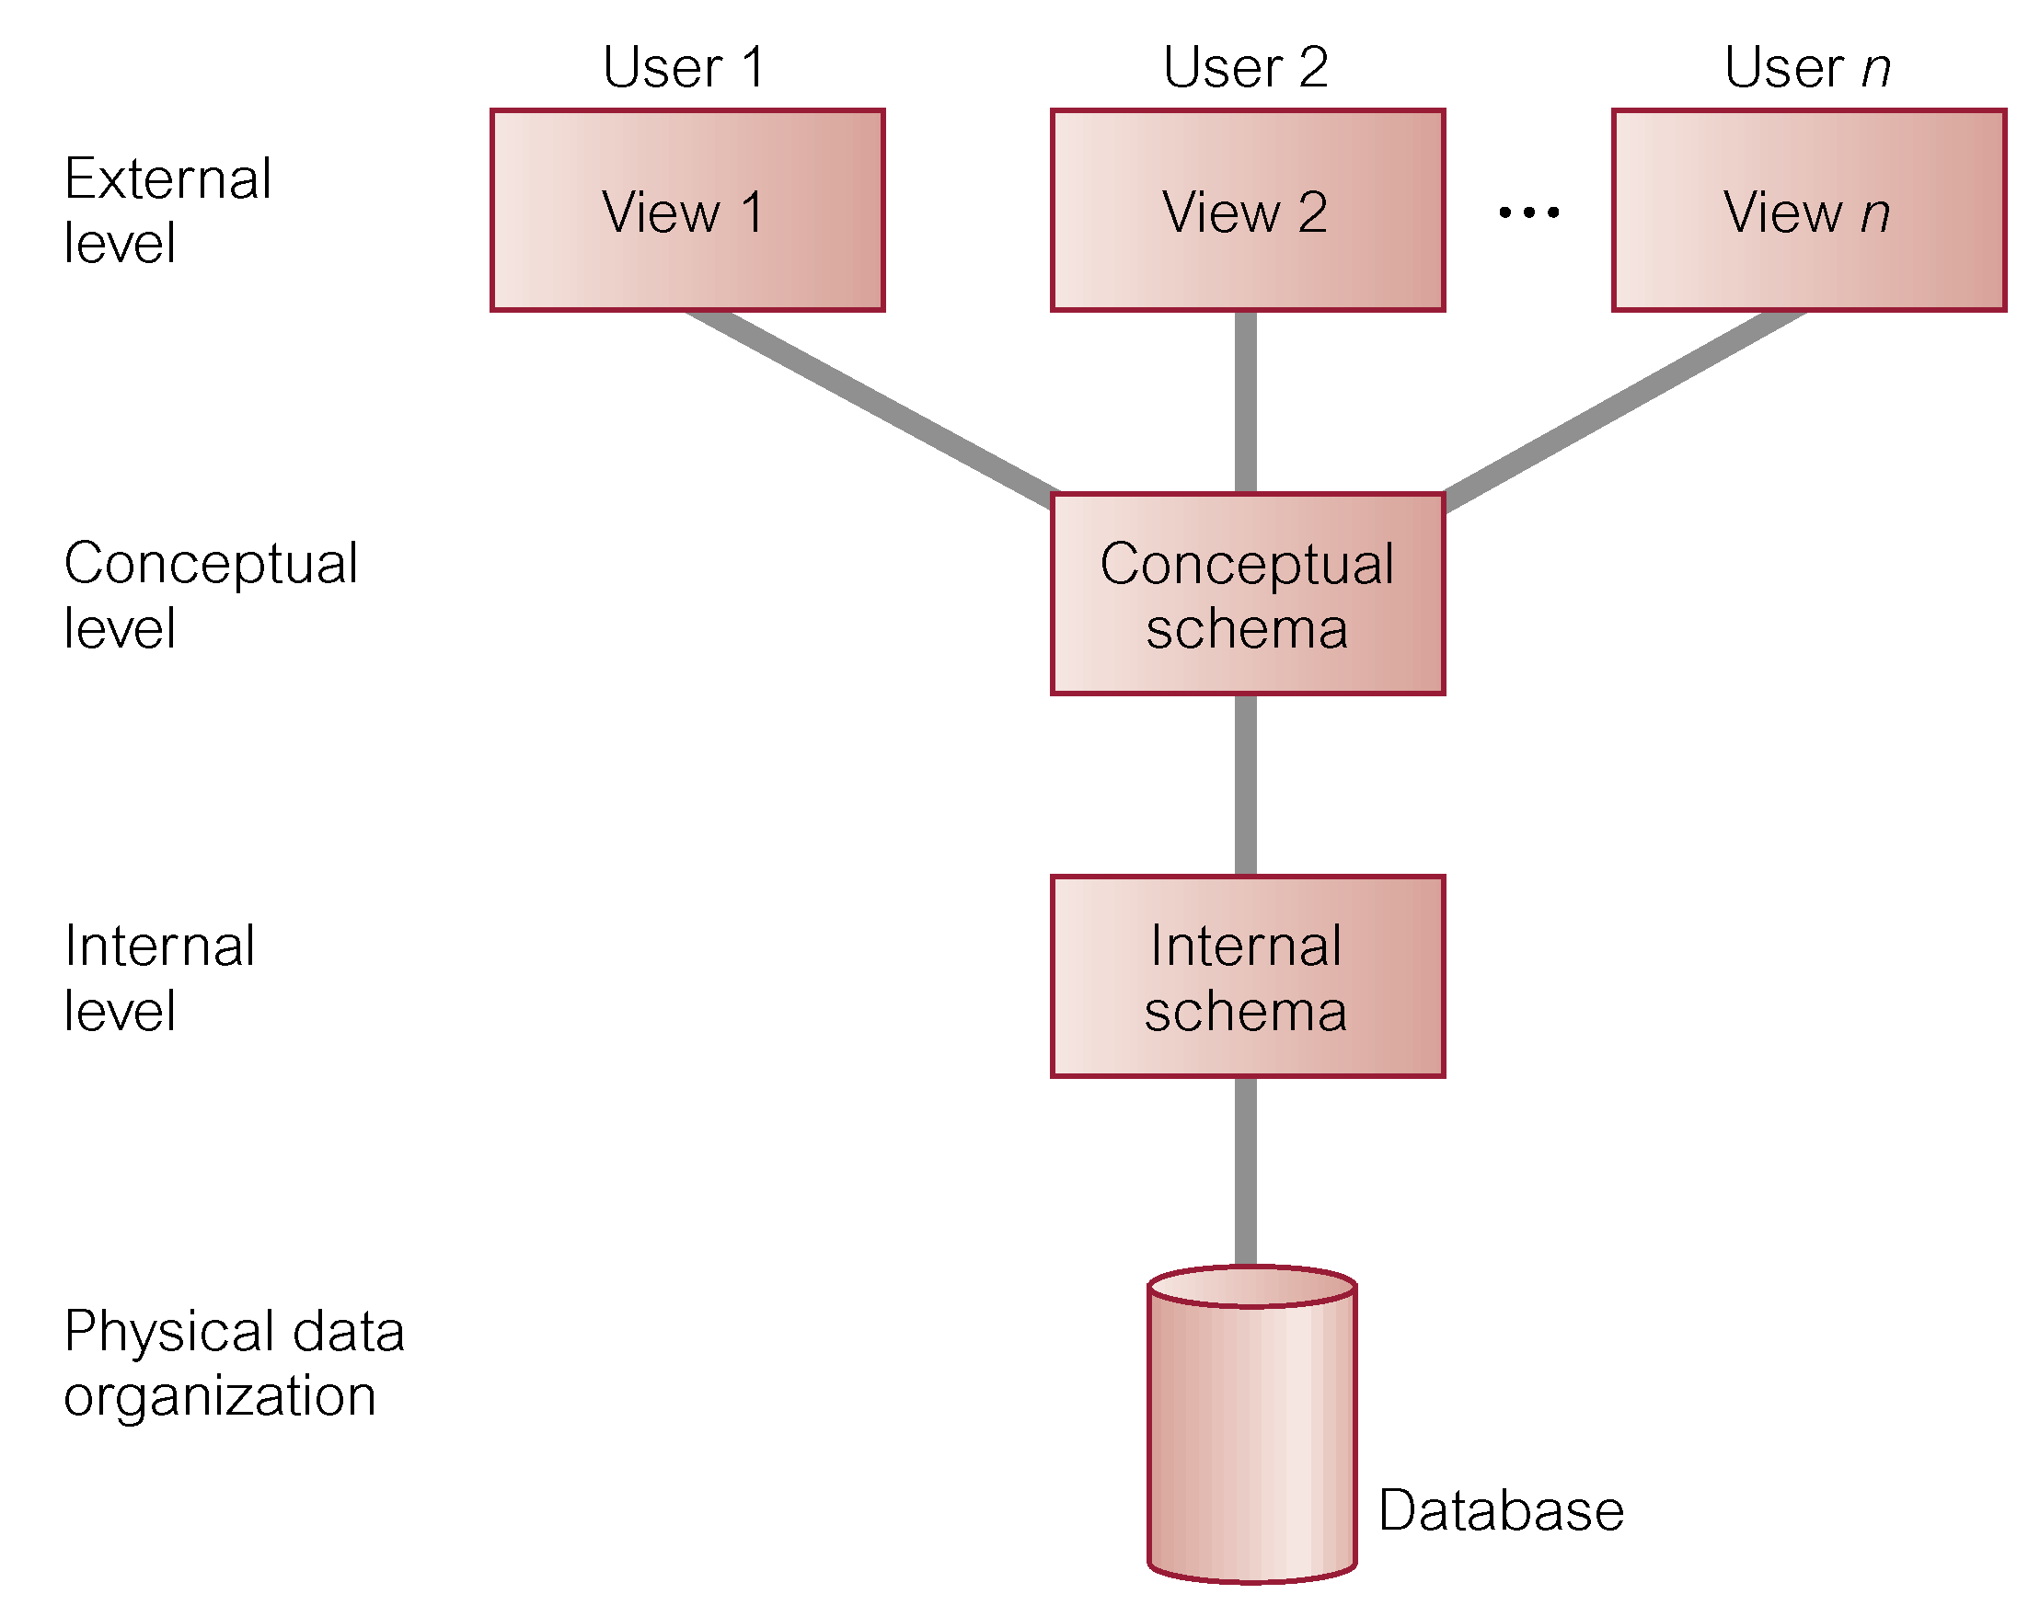

Slide 7
External Level
  Users’ view of the database.
  Describes that part of database that is relevant to a particular user.
Conceptual Level
  Community view of the database.
  Describes what data is stored in database and relationships among the data.

Slide 8
Internal Level
  Physical representation of the database on the computer.
  Describes how the data is stored in the database.

Slide 9
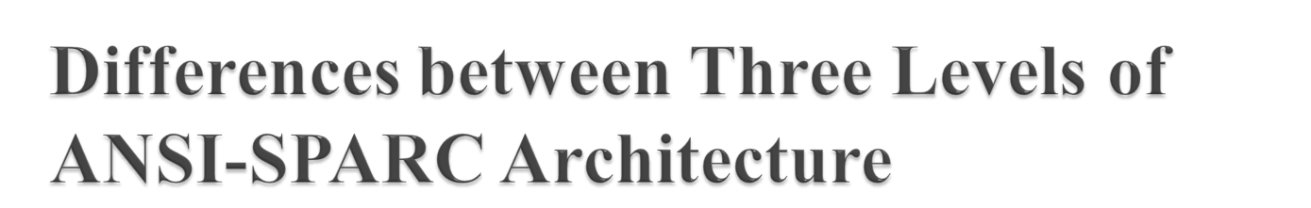
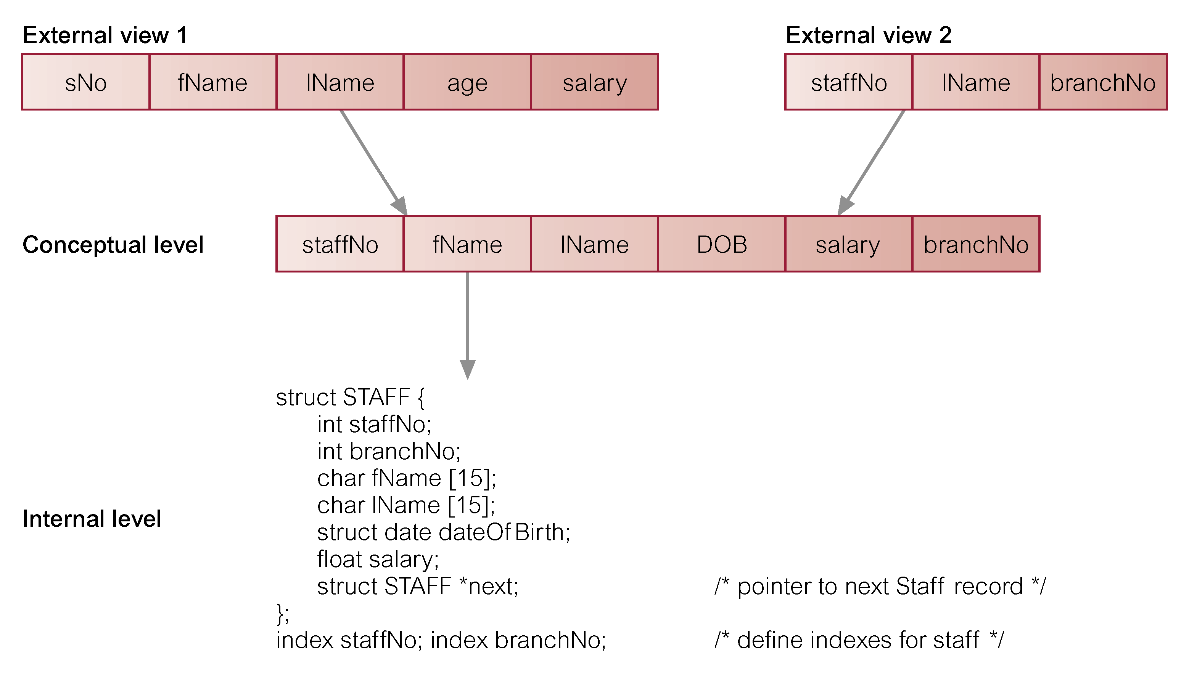

Slide 10

Logical Data Independence
  Refers to immunity of external schemas to changes in conceptual schema.
  Conceptual schema changes (e.g. addition/removal of entities).
  Should not require changes to external schema or rewrites of application programs.

Slide 11
Physical Data Independence
  Refers to immunity of conceptual schema to changes in the internal schema.
  Internal schema changes (e.g. using different file organizations, storage structures/devices).
  Should not require change to conceptual or external schemas.

Slide 12
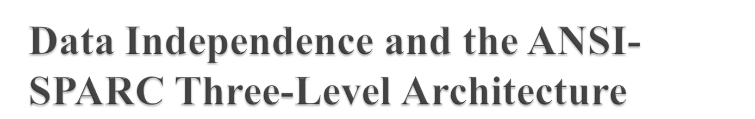
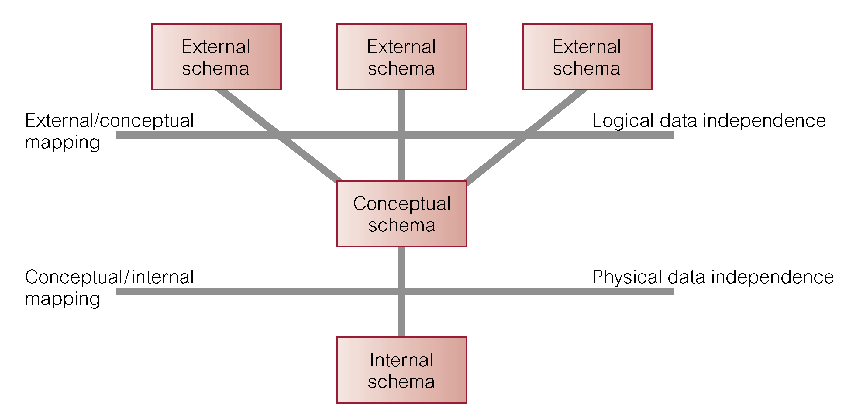

Slide 13

Data Definition Language (DDL)
  Allows the DBA or user to describe and name entities, attributes, and relationships required for the application
  plus any associated integrity and security constraints.

Slide 14
Data Manipulation Language (DML)
  Provides basic data manipulation operations on data held in the database.
Procedural DML
  allows user to tell system exactly how to manipulate data.
Non-Procedural DML
  allows user to state what data is needed rather than how it is to be retrieved.

Slide 15
Fourth Generation Language (4GL)
  Query Languages
  Forms Generators
  Report Generators
  Graphics Generators
  Application Generators.

Slide 16

Integrated collection of concepts for describing data, relationships between data, and constraints on the data in an organization.
Data Model comprises:
  a structural part;
  a manipulative part;
  possibly a set of integrity rules.

Slide 17
Purpose
  To represent data in an understandable way.
Categories of data models include:
  Object-based
  Record-based
  Physical.

Slide 18

Object-Based Data Models
  Entity-Relationship
  Semantic
  Functional
  Object-Oriented.
Record-Based Data Models
  Relational Data Model
  Network Data Model
  Hierarchical Data Model.
Physical Data Models

Slide 19

Conceptual schema is the core of a system supporting all user views.
Should be complete and accurate representation of an organization’s data requirements.
Conceptual modeling is process of developing a model of information use that is independent of implementation details.
Result is a conceptual data model.

Slide 20

Data Storage, Retrieval, and Update.
A User-Accessible Catalog.
Transaction Support.
Concurrency Control Services.
Recovery Services.

Slide 21
Authorization Services.
Support for Data Communication.
Integrity Services.
Services to Promote Data Independence.
Utility Services.

Slide 22

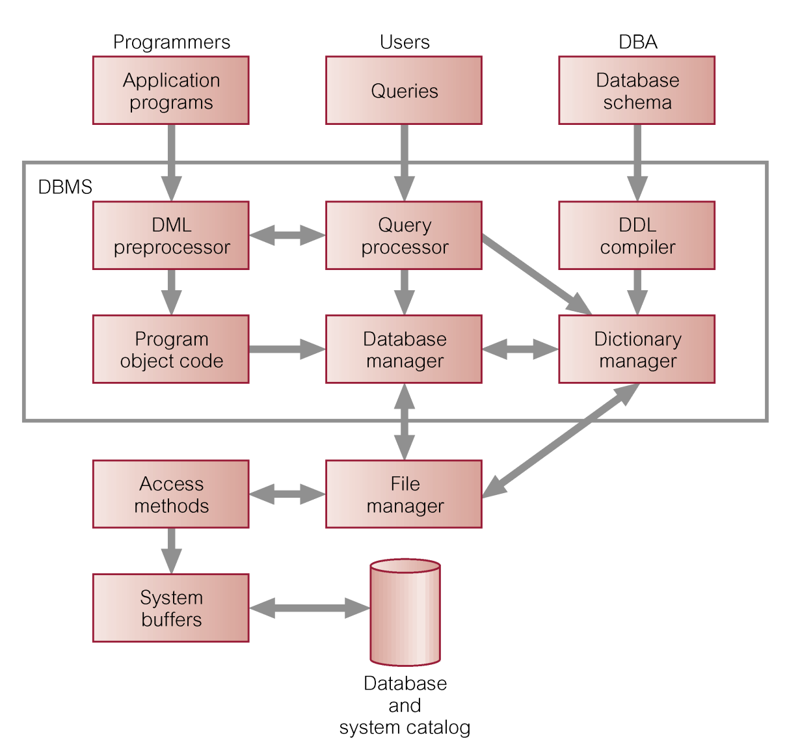

Slide 23
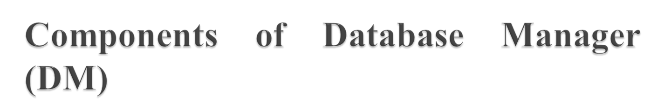
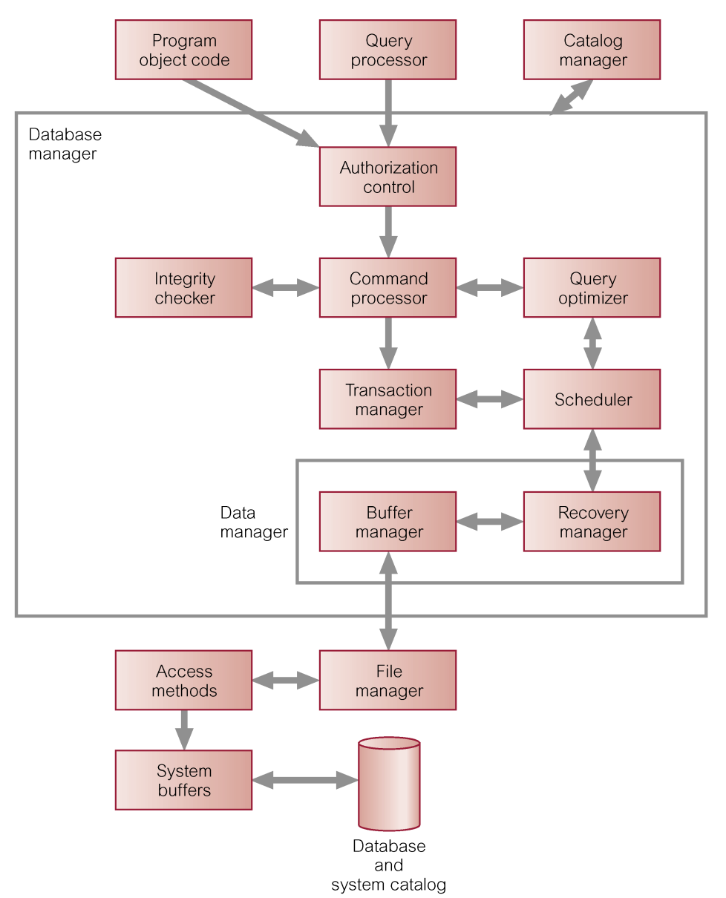

Slide 24

Teleprocessing
File-server
Client-server

Slide 25

Traditional architecture.
Single mainframe with a number of terminals attached.
Trend is now towards downsizing.

Slide 26

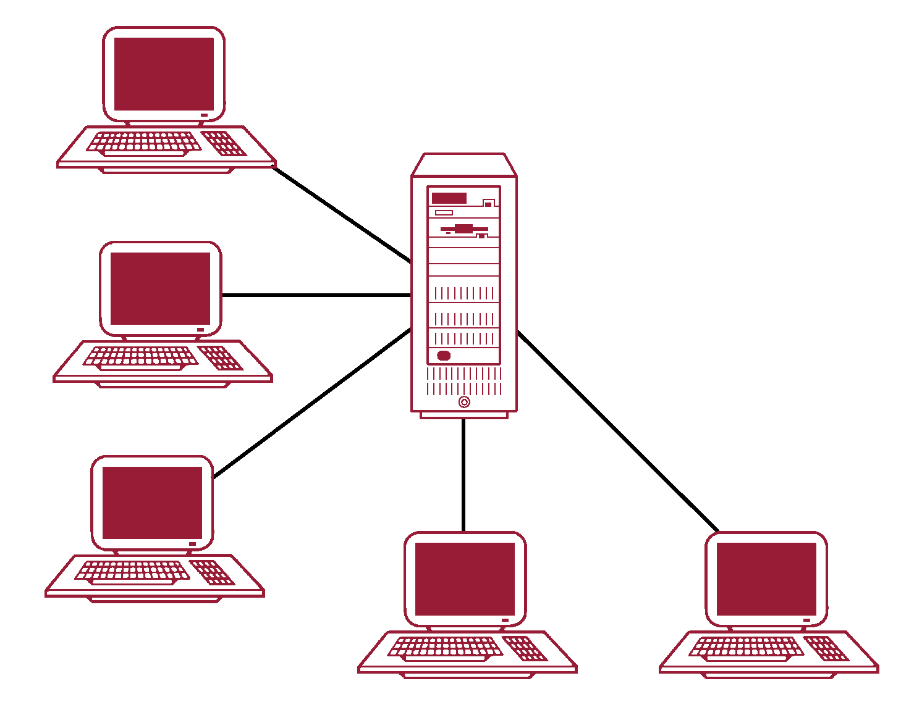

Slide 27

File-server is connected to several workstations across a network.
Database resides on file-server.
DBMS and applications run on each workstation.
Disadvantages include:
  Significant network traffic.
  Copy of DBMS on each workstation.
  Concurrency, recovery and integrity control more complex.

Slide 28

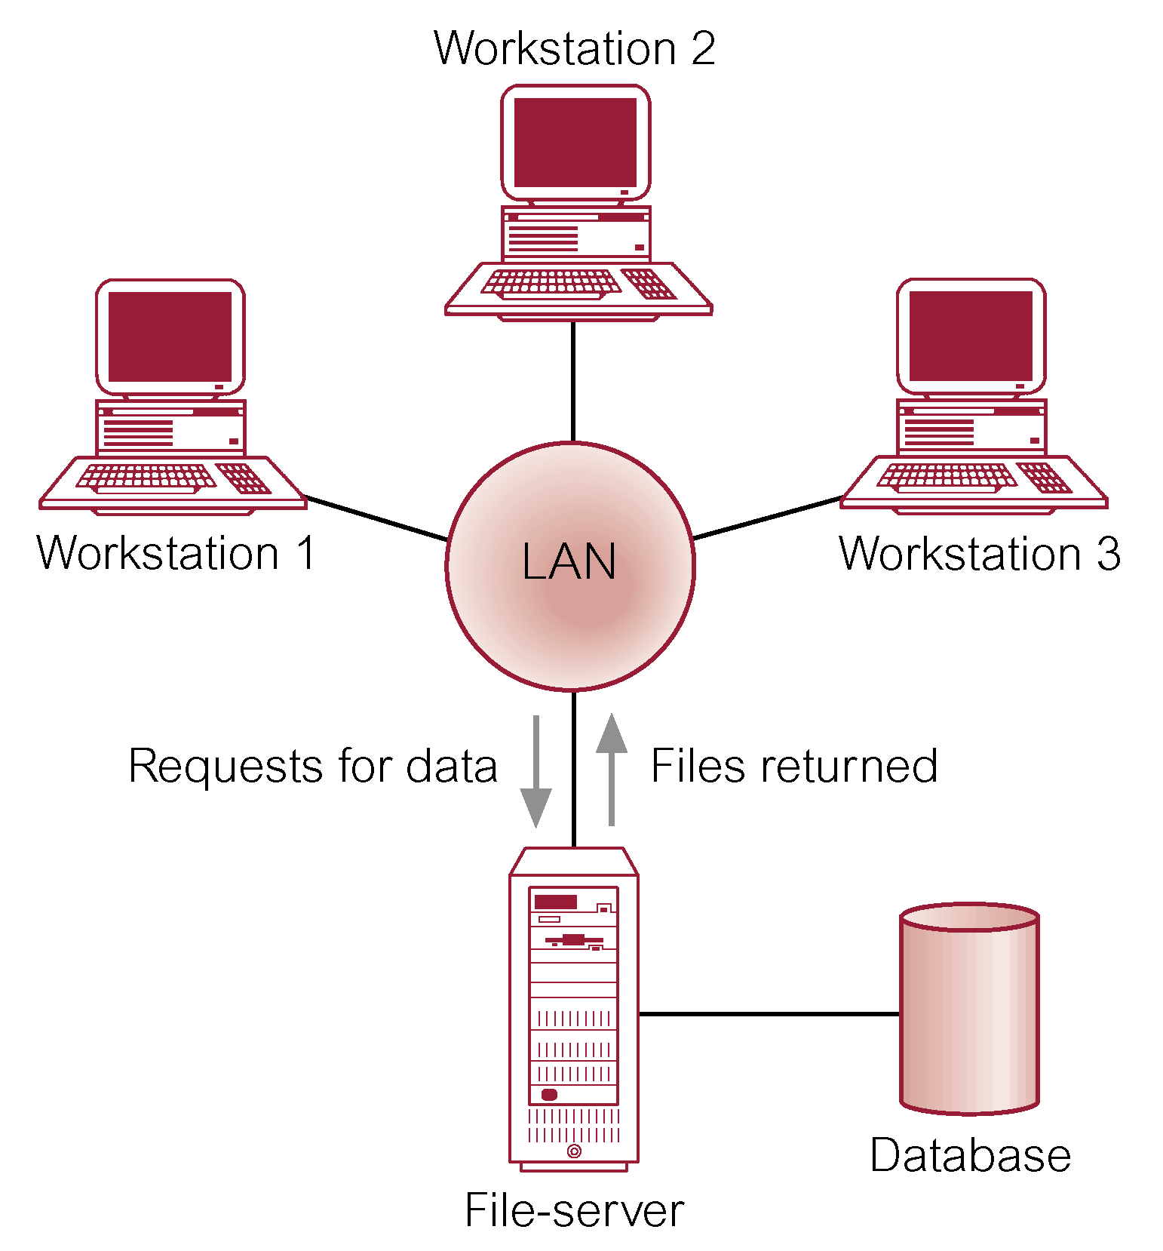

Slide 29

Server holds the database and the DBMS.
Client manages user interface and runs applications.
Advantages include:
  wider access to existing databases;
  increased performance;
  possible reduction in hardware costs;
  reduction in communication costs;
  increased consistency.

Slide 30

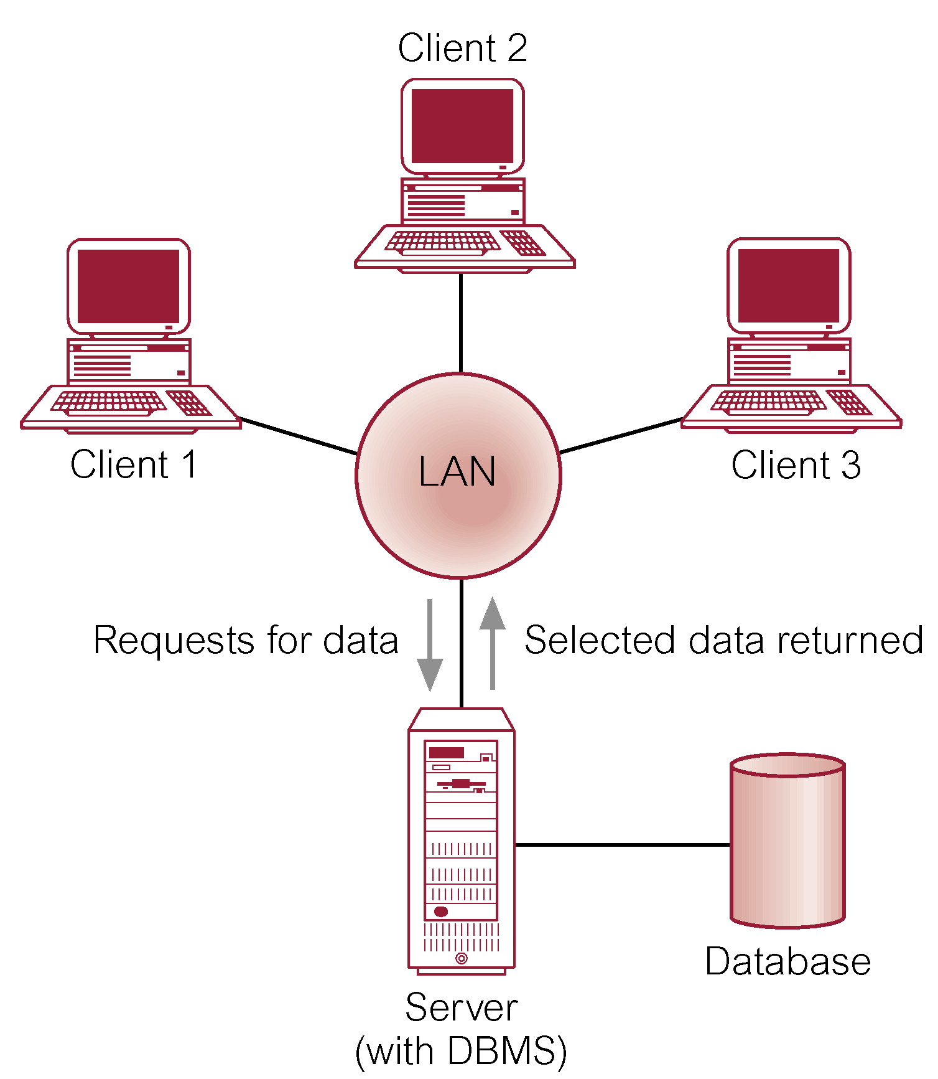

Slide 31

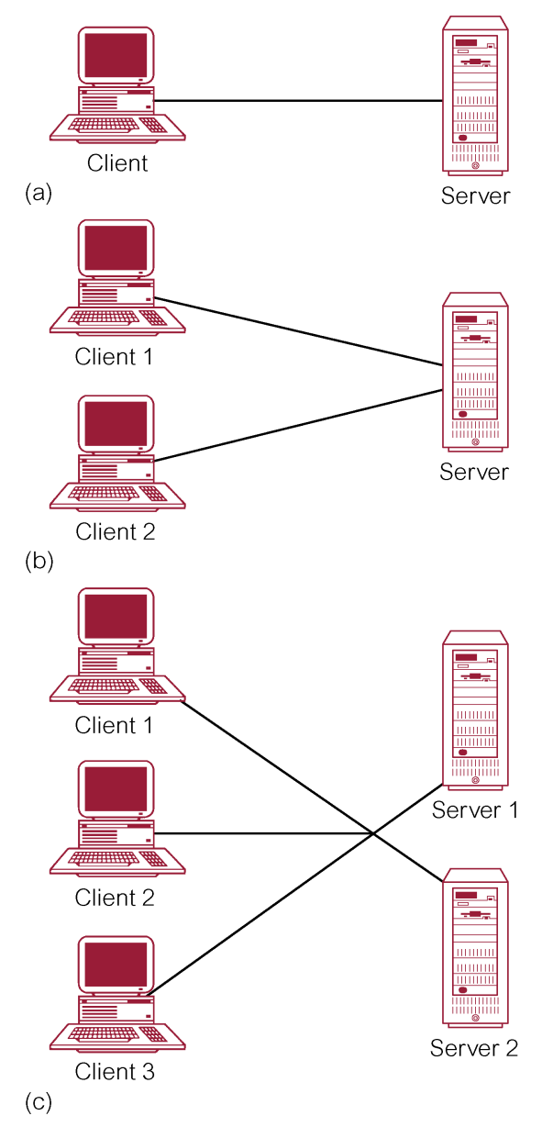

Slide 32

Program that controls data transfer between clients and servers in order to provide a consistent environment, particularly for Online Transaction Processing (OLTP).

Slide 33
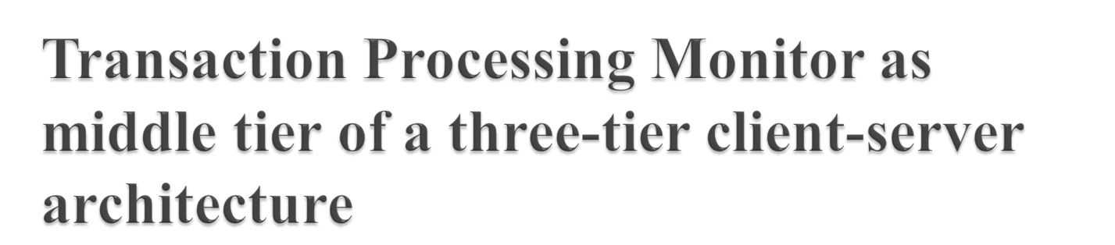
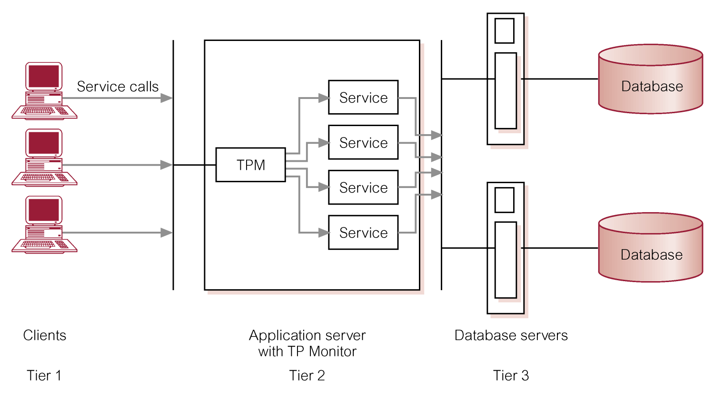

Slide 34

Repository of information (metadata) describing the data in the database.
Typically stores:
  names of authorized users;
  names of data items in the database;
  constraints on each data item;
  data items accessible by a user and the type of access.
Used by modules such as Authorization Control and Integrity Checker.

